Slide 1
XAML for Windows 10: ItemsControls
Daren May | President, CRANK211
Jerry Nixon| Developer Evangelist, Microsoft

Slide 2

Meet Daren May | ‏@darenmay
Daren May is the President and co-founder of Crank211 — a company that specializes in designing and building next-level digital experiences.
Daren has written and presented a number of MVAs and spoken at Microsoft Ignite. He has been developing XAML-based solutions since the heady days of “Avalon” (the early name for WPF).

Slide 3


Meet Jerry Nixon | ‏@jerrynixon
Microsoft Developer Evangelist
Reaching Professional & Student Communities
Teaching Developers about Windows
Teaching Developers about XAML
Author of Template 10
http://jerrynixon.com

Slide 4
Course Topics
XAML for Windows 10: ItemsControls
01 | ItemsControl Fundamentals
02 | Templates
03 | Tips and Tricks

Slide 5
Setting Expectations
Target Audience
Developers looking to make Universal Windows Apps
Suggested Prerequisites/Supporting Material
Basic C# knowledge
C# Fundamentals for Absolute Beginners
Basic XAML
XAML Deep Dive for Windows & Windows Phone Apps

Slide 6
01 | ItemsControl Fundamentals

Slide 7
Module Overview
ItemsControl Summary
Collection View Source & Semantic Zoom
Item Container Style

Slide 8
ItemsControl Summary

Slide 9
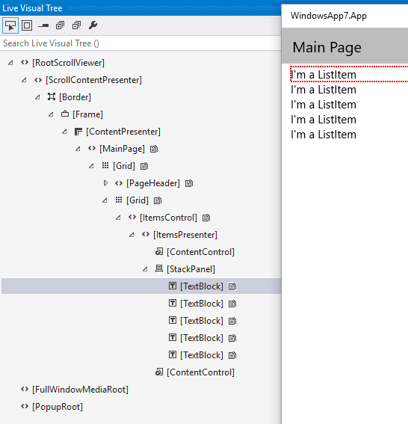
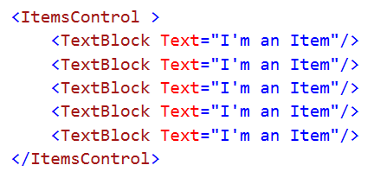
What is an ItemsControl?
Can present a static list of items
Populate Items

Slide 10
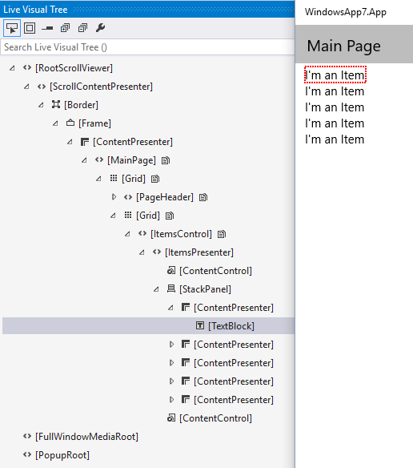
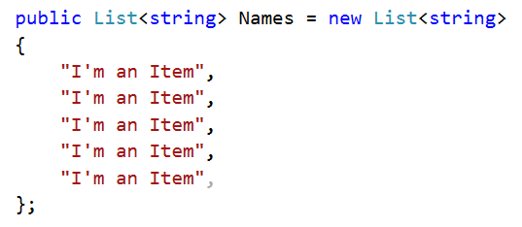
What is an ItemsControl?
Can display a list obtained from data binding
Use ItemsSource instead of Items

Slide 11
ItemsSource
Typically references a list of records.
IList<T>, array, ObservableCollection<T>
Use the ItemTemplate property, the ItemsPanel property, or both to specify the appearance of the records.

Slide 12
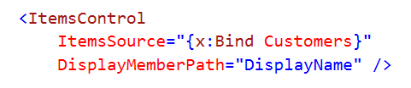
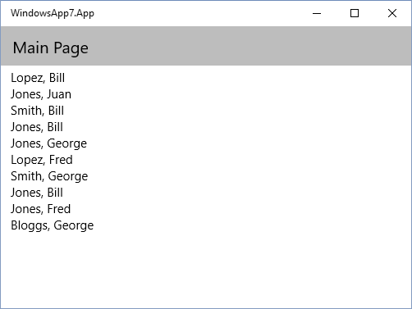
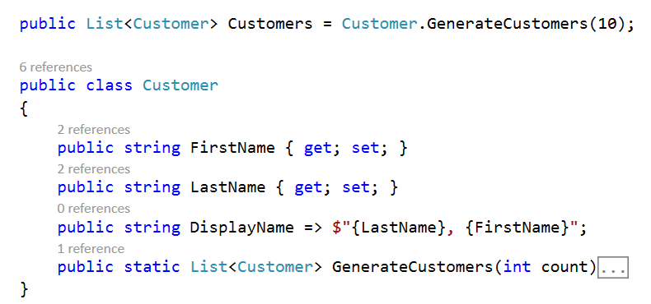
DisplayMemberPath

Slide 13
Common controls that derive from ItemsControl
You can use ItemsControl directly.
Also:
ListView
GridView
ListBox
Primitives.Selector-based: ComboBox, FlipView
MenuFlyoutPresenter

Slide 14
Guidelines for Lists
List views: primarily used to display text-heavy content
Grid views: primarily used to display image-heavy content
Drop-down lists: let users choose one from an expanding list
List boxes: let users choose one / multiple items from a list

Slide 15
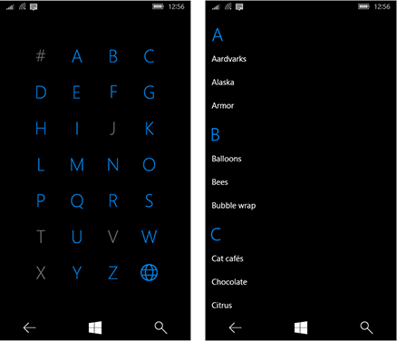
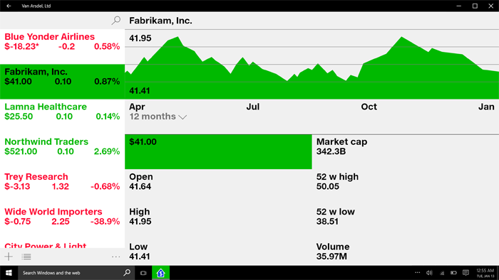
Lists
Display a content collection that primarily consists of text.
Navigate a single or categorized collection
Create the master pane in the master/details pattern.
Notes:
Image Content from https://msdn.microsoft.com/en-us/library/windows/apps/mt186889.aspx

Slide 16
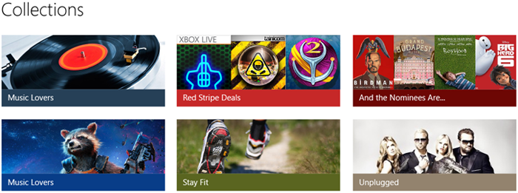
Grids
Display a content collection that primarily consists of images.
Display content libraries.
Format the two content views associated with semantic zoom.
Notes:
Image Content from https://msdn.microsoft.com/en-us/library/windows/apps/mt186889.aspx

Slide 17

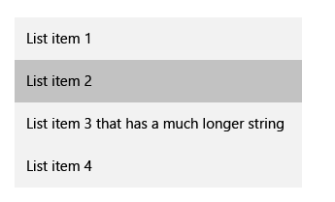
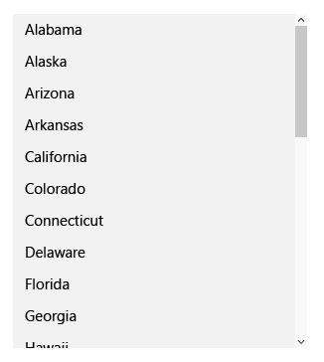
Drop-down Lists
Use a drop-down list to select a single value from a set of items that can represented with single lines of text.
Use a list or grid view instead to display items that contain multiple lines of text or images.
>5 items, consider using radio buttons or check boxes.

Slide 18
SelectionMode
Single: The user can select only one item at a time.
Multiple: The user can select multiple items without using a modifier (key).
Extended: The user can select multiple items with a modifier, such as holding down the SHIFT key.

Slide 19
CollectionViewSource & SemanticZoom

Slide 20
CollectionViewSource
Provides a data source that adds grouping and current-item support to collection classes.
Useful if you want to bind multiple list controls to same collection with the same selected item

Slide 21
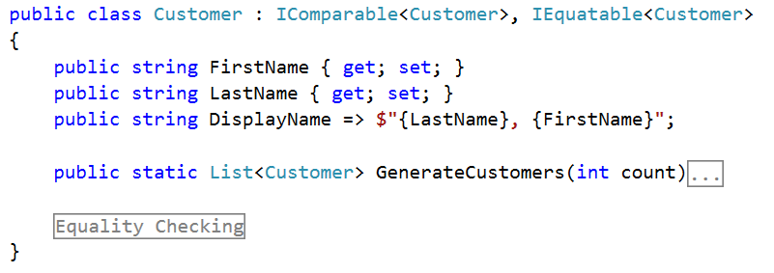
Building the item model

Slide 22
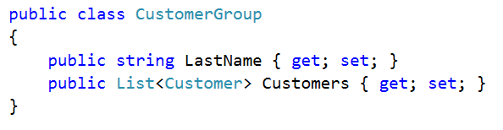
The grouped data definition

Slide 23
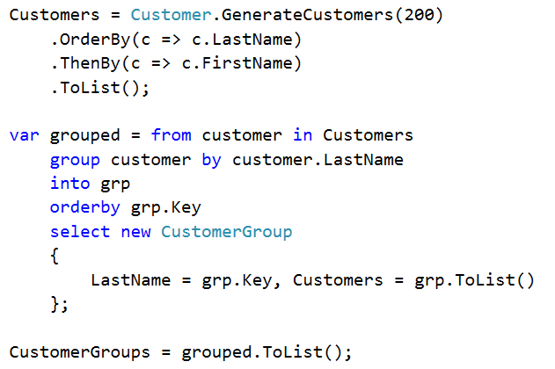
Building the grouped data

Slide 24
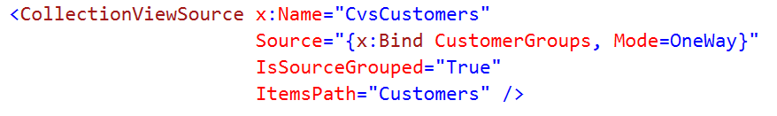
Declaring a CollectionViewSource

Slide 25
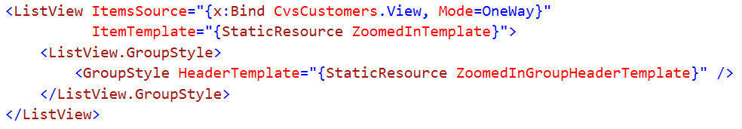
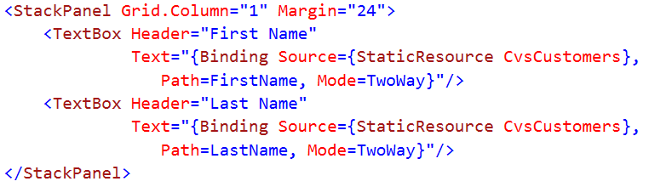
Consuming a CollectionViewSource
Master
Detail

Slide 26
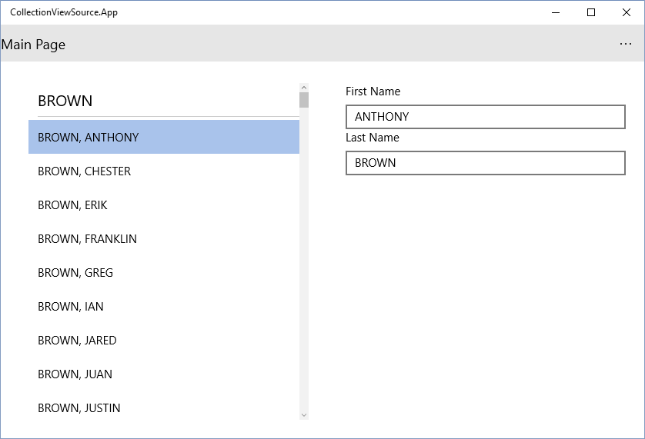
CollectionViewSource Master/Detail

Slide 27
SemanticZoom
Enables the user to zoom between two different views of the same content so that they can quickly navigate large data sets.
Zoomed-in view is the primary view of the content.
Zoomed-out view is a higher-level view of the same content.
Typically shows the group headers for grouped data.

Slide 28
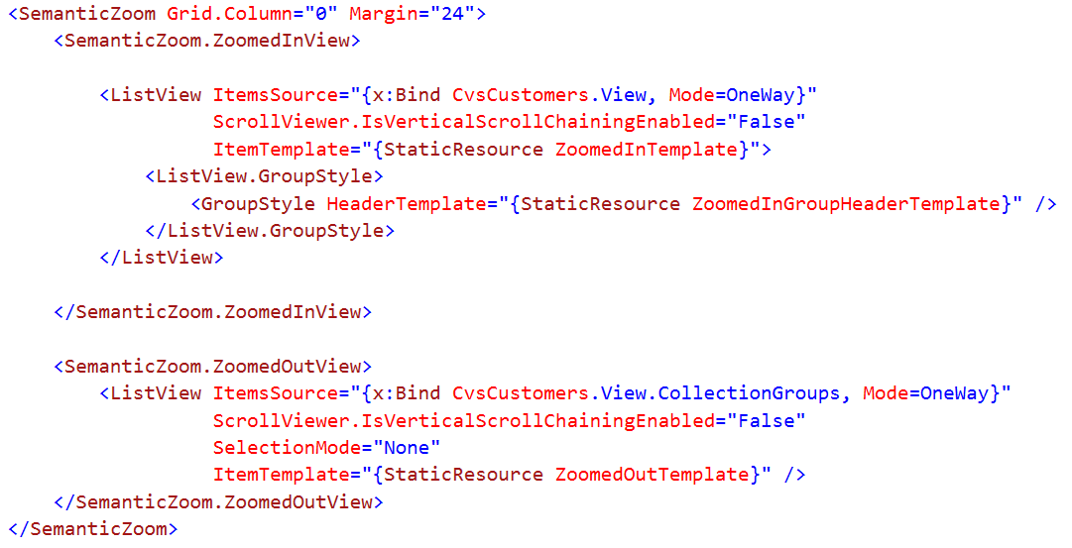
Defining the Views

Slide 29
CollectionViewSource and SemanticZoom

Slide 30
Item Container Style

Slide 31
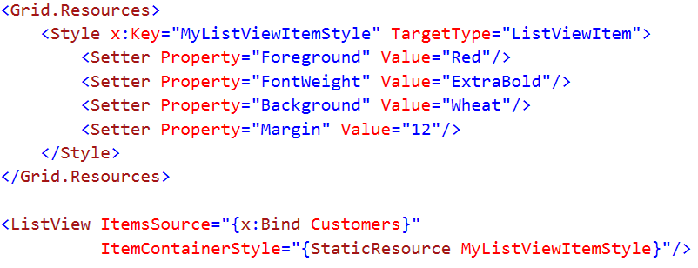
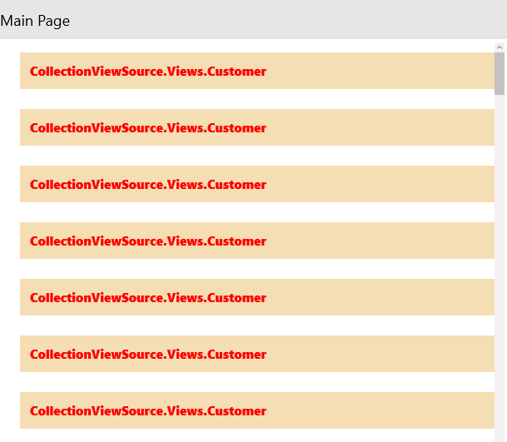
ItemContainerStyle
Provides a means to apply a style to each item shown in a list

Slide 32
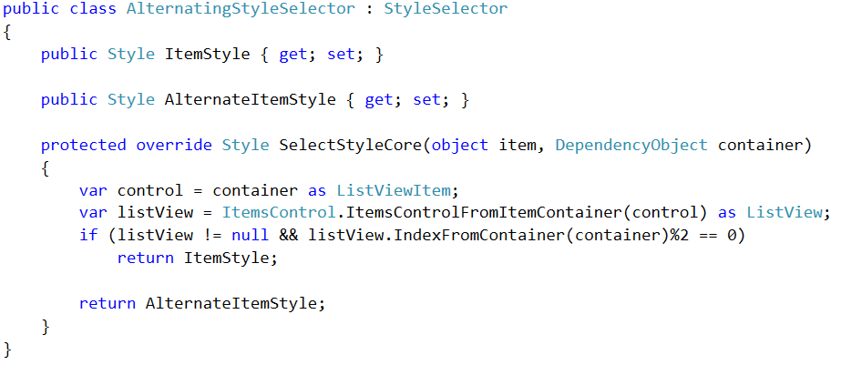
ItemContainerStyleSelector

Slide 33
ItemContainerStyle

Slide 34
Summary
ItemsControl Summary
Collection View Source & SemanticZoom
Item Container Style

